Slide 1
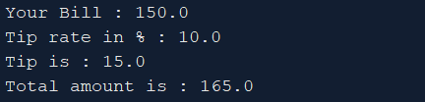

Slide 2
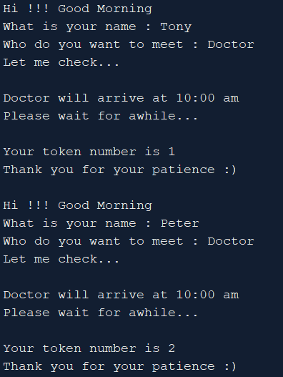

Slide 3
Class A
print y
y = 200
x = 10 ,y = 20, z = 30
Method1()
x = 100 //Global -white
Int z = 300 //local - blue
print x
print z
Method2()
print x
print z //global
Main()

Slide 4
Class A
print x
print y
print z
x = 100
y = 200
z = 300
x = 10 ,y = 20, z = 30
Method1()
y = 500
IF
Int y = 200 // local to “if”
ELSE
IF
IF
print y
Main()
ELSE

Slide 5
Class A
print x
print y
print z
x = 100
y = 200
z = 300
x = 10 ,y = 20, z = 30
FOR
Method1()
WHILE
IF
Main()
ELSE

Slide 6
Class A
Class B
Class C
Method1()
Main()
Method1()
Method2()
Main()
Main()
Package ABC
Class A
Main()

Slide 7
Package ABC
Class A
Class A
Main()
Main()

Slide 8
Package ABC
Package ABC
Class Z
Class Z
Method1()
Method1()
Method2()
Method2()
Main()
Class A
Class A
Main()
Main()

Slide 9
Package ABC
Class Z
Method1()
Method2()
Class Y
Method3()
Class A
Main()

Slide 10
Package ABC
import ABC.* or import ABC.A
Package XYZ
Class Z
Method1()
Method2()
Class X
Class Y
Method3()
Class P
Class A
Main()

Slide 11
Package ABC
Class Z
Method1()
Method2()
Class Y Inherits Z
Method3()
Class A
Main()

Slide 12
Package ABC
Package ABC
Class Z
Class Z
Method1()
Method1()
Method2()
Method2()
Class Y
Class Y
Method3()
Method3()
Class A
Class A
Main()
Main()

Slide 13
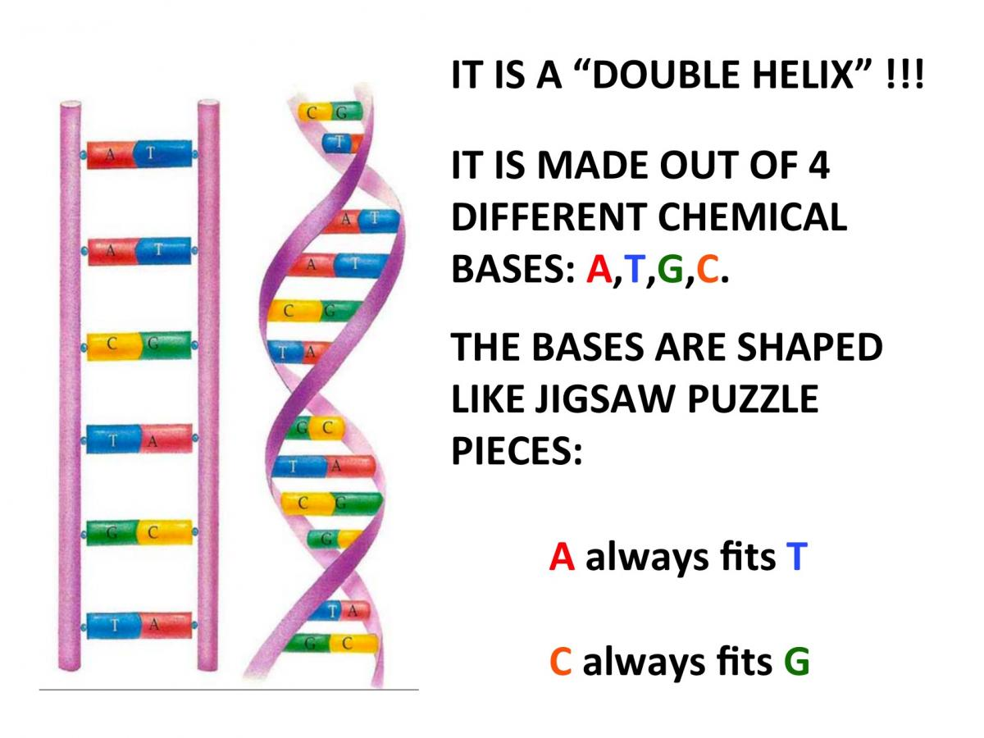
This Photo by Unknown Author is licensed under CC BY-SA-NC

Slide 14
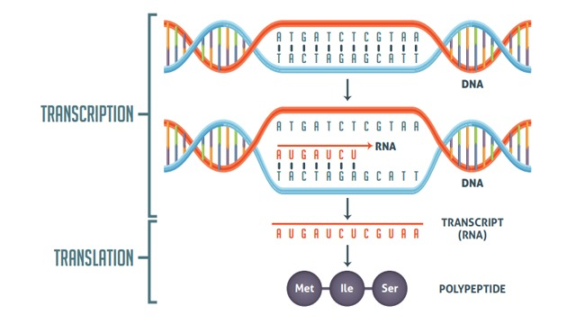
What we care in our problem ?
There is start codon and stop codon, we would like to return everything in between.
Eg : Start Codon : ATG and Stop Codon : TAG
The “string” or “gene” part comes in group of 3’s. Simply means there is pattern to it.

